Slide 2
Why Does This Church Exist?

Slide 3
To Make
JESUS
and
His SAVING WORK
Known!

Slide 5
Thy kingdom come.
Thy will be done
on earth
as it is in heaven.

Slide 7
Then Jesus came to them and said,
“All authority
in heaven and on earth has been given to me.

Slide 8
Therefore go and make disciples of all nations, baptizing them in the name of the Father and of the Son and of the Holy Spirit, and teaching them to obey everything I have commanded you. And surely I am with you always, to the very end of the age.” Matthew 28:18-20

Slide 10
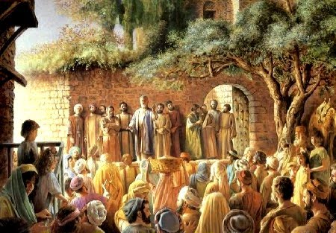
“Repent and be baptized. . .”

Slide 12
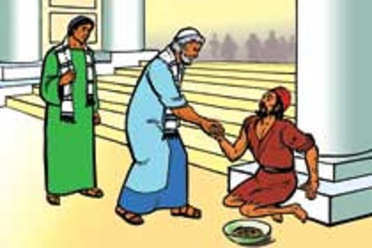
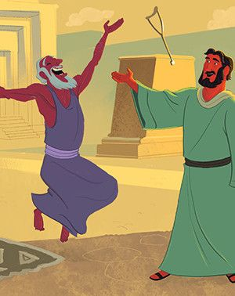
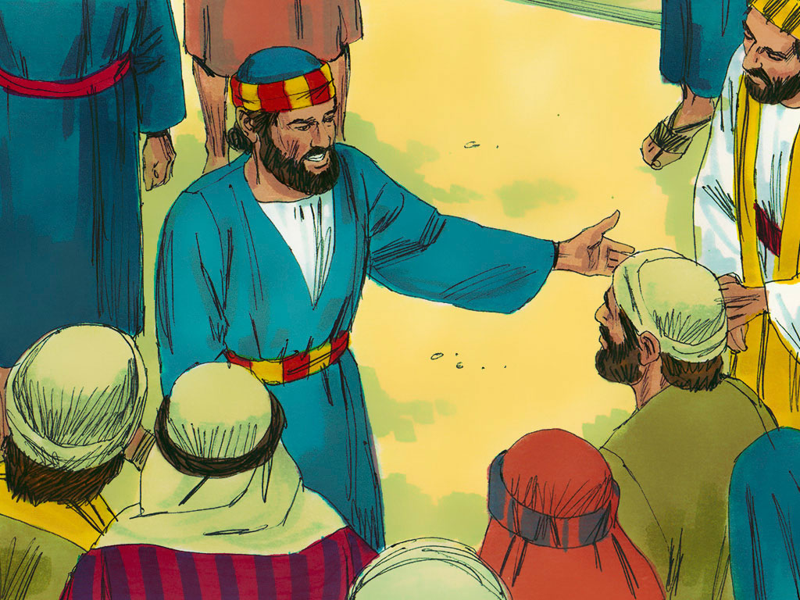
Repent – Turn to God
Your sins will be wiped out!

Slide 13
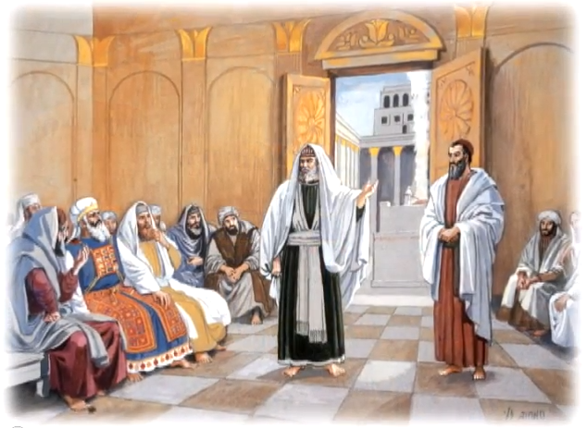
Salvation is found
in no one else. . .

Slide 15
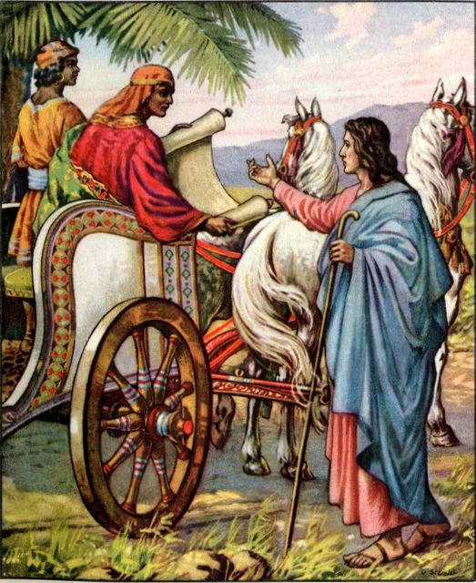
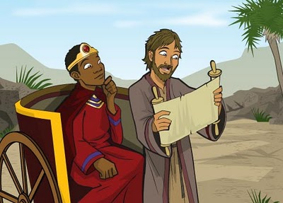

Slide 17
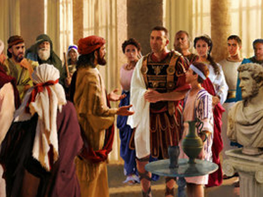
While Peter was still speaking these words, the Holy Spirit came. . .

Slide 19
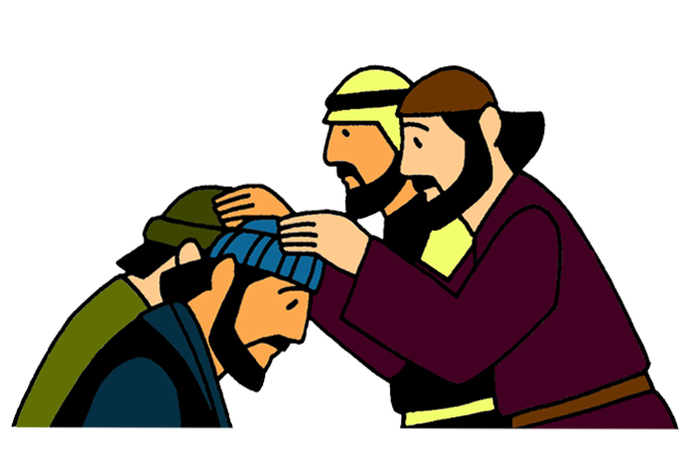
Set apart for me
Barnabas and Saul. . .
. . . and they sailed. . .

Slide 21
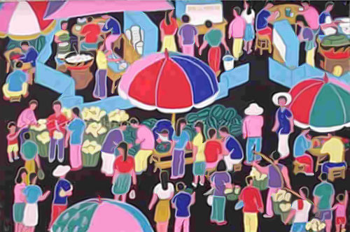
They shared with anyone who would listen. . . A great number of people believed and turned to the Lord!

Slide 23
Just Report for duty every morning.
Then, just OBEY Jesus!

