Slide 1
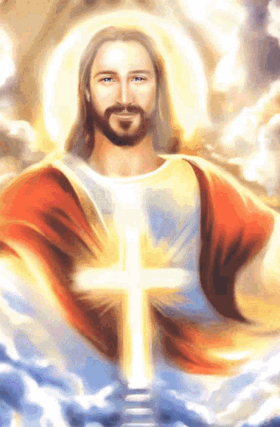
Jesus’
Letters to the
7 Churches

Slide 2
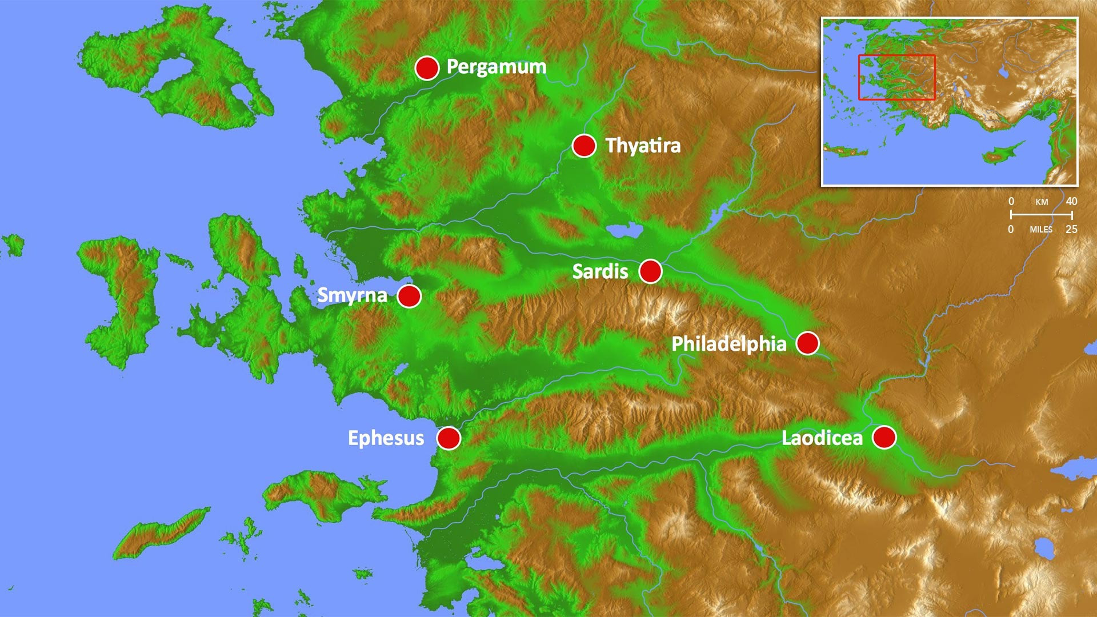
Patmos
Courtousy of Digital Globe / FreeBibleimages.org.

Slide 4
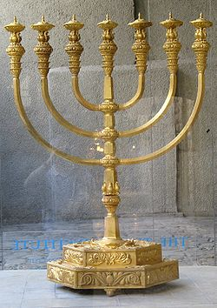
= Pastor of the Congregation
= Church Congregation

Slide 5
EPHESUS:
Worked hard
Persevered under trial
Doctrinally sound
But – Didn’t love Jesus – Didn’t hang out with Him!
Patmos
Courtousy of Digital Globe / FreeBibleimages.org.

Slide 6
SMYRNA:
Persecuted
Poor
Rich in Christ – Faithful even to death
Patmos
Courtousy of Digital Globe / FreeBibleimages.org.

Slide 7
PERGAMUM:
True to Christ – Did not deny Him
Tolerated false teachers and non-biblical doctrine
Patmos
Courtousy of Digital Globe / FreeBibleimages.org.

Slide 8
THYATIRA:
Working
Loving
Persevering
Expanding ministry
Tolerated sexually immoral and idolatrous leaders
Patmos
Courtousy of Digital Globe / FreeBibleimages.org.

Slide 9
SARDIS:
Reputation of Being Alive
Dead – Failed to actively share Jesus
Patmos
Courtousy of Digital Globe / FreeBibleimages.org.

Slide 10
PHILADELPHIA:
Faithful to actively share Jesus
Patmos
Courtousy of Digital Globe / FreeBibleimages.org.

Slide 11
LAODICEA:
Wretched, pitiful, poor, blind, naked
Didn’t hang out with Jesus
Patmos
Courtousy of Digital Globe / FreeBibleimages.org.

Slide 12
SUMMARY OF JESUS’ EVALUATIONS OF THE 7 CONGREGATIONS
Jesus’ Observations
Worked hard
Persevered under trial
Doctrinally sound
Persecuted
Poor
True to Christ – Did not deny Him
Loved people
Expanding ministry
Reputation of Being Alive
Reasons for Jesus’ Bad
Evaluation
Didn’t love Jesus
Didn’t hang out with Jesus
Tolerated false teachers and heretical doctrine
Tolerated sexually immoral and idolatrous leaders
Dead – Failed to actively share Jesus (being ashamed of Jesus)
Reasons for Jesus’ Favorable Evaluation
Rich in Christ
Did the right stuff
Faithful to actively share Jesus
They hung out with Jesus. They spend time with Him in prayer and in His Word.

Slide 13
BLESSINGS JESUS PROMISED TO THOSE WHO OVERCOME AND ARE VICTORIOUS
Will have the right to eat from the tree of life – We’ll live with Jesus forever.
Will not be hurt by the second death – We won’t go to Hell.
Will receive manna – Jesus, the bread from Heaven, will nourish us.
Will be given a white stone with a new name – God accepts us.
Will be given authority over the nations – We will rule with Christ.
Will be given the morning star – We will have Jesus. He will give us Himself.
Will be dressed in white – We will be pure in Jesus’ sight.
Will not be blotted out of the Book of Life - We’ll live with Jesus forever.
Will be acknowledged before God and the angels – Jesus will claim us as His own.

Slide 14
BLESSINGS JESUS PROMISED TO THOSE WHO OVERCOME AND ARE VICTORIOUS (continued)
Will be a pillar in God’s temple – We will have a continual role in the worship of God.
Will have the Name of God and the name of the new Jerusalem written on us – We will be marked as God’s own possession.
Will have the right to sit with Jesus on His throne – We will be in constant fellowship with Jesus, hanging out with Him and ruling with Him.
HALLELUJAH!

